Slide 1

Context Aware AI
For Cybersecurity
using RAG

Slide 2


Large Language Models (LLMs)
LLMs compress world knowledge, revolutionizing how we understand, generate, and secure information.

Slide 3
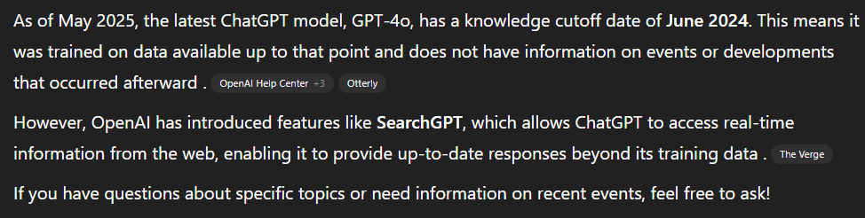

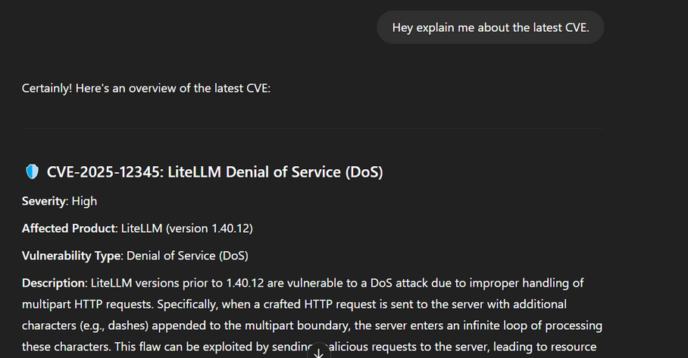
Limitations of Current LLMs in Cybersecurity
1. Knowledge Cut-off
What if we can retrieve,
2. Lack of Domain Specificity
Up-to-date documents
Domain-specific data
Retrieval
Augmented
Generation

Slide 4






RAG Architecture: How it works
Query
Response
Contextual Data (Top-k)
Query Embedding
Original
Database
Vector Database
Embedding
Chunking

Slide 5




RAG framework for Cybersecurity
Cyber Threat Intelligence Augmentation
Dynamic Incident Response Assistant
Vulnerability Management & Patch Recommendations
Context-Aware Log Analysis
Cybersecurity Awareness and Training

Slide 6
RAG-based LLM PoC: Tools Used
Content | Purpose | Tool/Library | Remarks
Embedding Model | Converts text into dense vector embeddings | HuggingFaceEmbedding from llama-index-embeddings-huggingface | "BAAI/bge-small-en-v1.5" from Hugging Face
Vector Store Index | Creates an index from document embeddings | VectorStoreIndex from llama_index | Index is used to support similarity search
Retriever | Finds relevant documents based on a query | VectorIndexRetriever from llama_index | Retrieves top k documents (top_k=3) based on similarity
Postprocessor | Filters results based on similarity cutoff | SimilarityPostprocessor from llama_index | Filters out results with similarity < 0.5
Language Model (LM) | Generates responses based on prompts and/or context | TheBloke/Mistral-7B-Instruct-v0.2-GPTQ | 7B parameters, fast inference
Tokenizer | Tokenizes inputs to be fed into the LLM | AutoTokenizer from transformers
Inference | Generates text response from model output | .generate() from Hugging Face Transformers | Sets max_new_tokens, uses attention_mask, pad_token_id, etc

Slide 7
RAG-based LLM PoC: Flow
Importing Libraries
(llamaindex, huggingface, etc)
Importing LlamaIndex framework components
(embedder, directoryreader, etc)
Defining embedding settings
(chunk size, overlap)
Setting up the Retriever
(top ‘k’ chunks with similarity)
Setting up the external database
(mounting gDrive and storing in a VDB)
Importing the LLM
(Mistral-7B-Instruct-v0.2-GPTQ)
Testing the LLM without contextual data
(User Query)
Testing the LLM with contextual data
(User Query + Contexual Data)
Evaluation

Slide 8
1. The Good and The Bad: Exploring Privacy Issues in Retrieval-Augmented Generation (RAG)
Objectives: This study investigates privacy leakage risks in Retrieval-Augmented Generation (RAG) systems by addressing two key questions: whether private data can be extracted from the external retrieval database, and how retrieval affects the memorization and potential leakage of the LLM’s training data. The goal is to understand both the vulnerabilities and the influence of retrieval on LLM behavior within the RAG framework.
Methodology: This study conducts two types of black-box attacks, targeted and untargeted, to assess privacy leakage risks in RAG systems. The attacks are based on modifying queries structured into an {information} part to trigger data retrieval from the external database, and a {command} part to prompt the LLM to generate and potentially expose the retrieved content.
Results: In the first setup, both untargeted and targeted attacks achieved high success rates in extracting private data, revealing the vulnerability of RAG systems to retrieval data extraction. However, simple mitigation methods have reduced sensitive data exposure from the external database. In the second setup, targeted and prefix attacks showed that incorporating retrieval in the RAG framework substantially lowers the risk of PII leakage from the LLM’s training data.
Limitations: The study focuses only on the use of retrieval augmentation during inference and does not explore its impact during pre-training or fine-tuning. Additionally, the privacy risks of other retrieval-based language model architectures remain unexplored, and future work is needed to develop strategies for protecting retrieval data and using RAG systems to safeguard training data.
Implications: This study investigated the privacy risks of Retrieval-Augmented Generation (RAG) for large language models, demonstrating that RAG systems are vulnerable to retrieval data extraction attacks. At the same time, the study found that incorporating retrieval data can help reduce training data leakage, offering both risks and potential privacy benefits when using the LLMs.
Future Work: This study is limited to inference-time retrieval, and future research should investigate the integration of RAG into the pre-training and fine-tuning stages to assess its impact on privacy leakage. Additionally, more robust mitigation strategies for data leakage in RAG frameworks need to be developed. Establishing an experimental setup to validate the observation that RAG can reduce data exposure may support the privacy-by-design LLM systems. Further exploration is also needed to determine optimal command structures that enhance data privacy in RAG-based language models.

Slide 9
2. Boosting Cybersecurity Vulnerability Scanning based on LLM-supported Static Application Security Testing
Objectives: This research aims to develop a novel vulnerability scanning framework, LSAST (LLM-supported Static Application Security Testing), by integrating traditional SAST tools with LLM capabilities to enhance the accuracy and relevance of vulnerability detection. Additionally, it seeks to benchmark the effectiveness of the RAG-based LSAST framework by comparing its performance against that of unassisted LLMs in detecting software vulnerabilities.
Methodology: This research involves integrating the Bearer SAST scanner with an LLM to form LSAST by utilizing Bearer's output to guide the LLM in vulnerability detection. To enhance the LLM's understanding of recently updated security insights, a retrieval-augmented system selectively delivers the most relevant recent vulnerability reports using one of eight knowledge retrieval methods based on code functionality, abstraction, or SAST results.
Results: In the first evaluation, it focused on finding the best RAG approach for small-scale SAST, the abstraction-based and combined approaches performed better than the functionality-based method, as abstraction accurately captures underlying vulnerability patterns.
In the knowledge retrieval evaluation, the “raw LSAST” approach (which uses Bearer SAST results without any knowledge retrieval) outperformed both the “combined LSAST” approach (which uses both knowledge retrieval and Bearer results) and the “raw” approach (which excludes both knowledge retrieval and Bearer).
Limitations: This research is limited by the poor quality of vulnerability data from HackerOne, which mixed code and descriptions, forcing the use of LLMs to extract code. It also lacks consistent code abstraction methods, uses only a few programming languages, and does not apply techniques like ensemble methods to improve accuracy and consistency.
Implications: This study demonstrates that integrating static code scanner outputs with an LLM significantly enhances vulnerability detection beyond traditional SAST capabilities, highlighting the strength of combined analytical methods. It also introduces improved knowledge retrieval approaches that set new benchmarks for precision in vulnerability context delivery, while emphasizing the critical importance of relevance in retrieved data to avoid distracting the LLM's focus.
Future Work: The SAST and DASt with RAG-based LLM frameworks should focus on applying chain of thought reasoning to improve logical processing in vulnerability detection. Research is also needed to explore scanning entire repositories without chunking requests, allowing the LLM to retain full context and better understand the entire codebase. Additionally, the consistency of results should be enhanced by applying ensemble methods to aggregate predictions from multiple scans with different hyperparameters, which could help reduce false positives and increase reliability. Finally, improvements in the knowledge retrieval system would further refine LLM integration in vulnerability scanning processes.

Slide 10
3: SOSecure: Safer Code Generation with RAG and Stack Overflow Discussions
Objectives: This study aims to enhance the security of LLM-generated code by introducing SOSecure, a post-generation layer that uses vulnerability-focused Stack Overflow discussions to identify and revise insecure code, without retraining the LLM.
Methodology: The methodology follows three main steps: SO data collection, knowledge base construction, and a retrieval system. Security-relevant Stack Overflow posts are collected to build the knowledge base. Then, when given LLM-generated code, the retrieval system fetches related discussions to help the LLM identify and fix potential vulnerabilities.
Results: The results show that SOSecure significantly outperforms baseline LLM approaches in fixing security vulnerabilities across three benchmark datasets, achieving Fix Rates of up to 96.67% while maintaining a 0% rate of introducing new vulnerabilities. It consistently improves detection across various vulnerability types, especially those with high or critical severity. SOSecure also generalizes well across programming languages like Python and C, and its effectiveness peaks when retrieving about five relevant Stack Overflow discussions, beyond which performance declines due to contextual noise.
Limitations: The study is limited by potential inaccuracies in CodeQL and its reliance on CWEs with default queries. SOSecure’s effectiveness depends on the quality and relevance of Stack Overflow discussions, which may be lacking for niche technologies. It also struggles when secure fixes require knowledge not explicitly mentioned in retrieved content, and sometimes retrieves discussions focused on debugging rather than security, leading to incomplete fixes.
Implications: This research highlights the potential of retrieval-augmented methods like SOSecure to enhance the security of LLM-generated code by leveraging real-world developer discussions. Its language-agnostic design, ease of integration, and ability to continuously improve through updated Stack Overflow content make it a scalable and practical solution. The consistent performance across varying vulnerability types and programming languages demonstrates the value of community-driven knowledge in strengthening AI-assisted coding practices.
Future Works: Incorporating more diverse and complementary Stack Overflow discussions instead of relying solely on the top-k retrieved posts. Enhancing the retrieval strategy with advanced filtering and ranking mechanisms could help avoid irrelevant or debugging-focused content and better capture nuanced security guidance. Additionally, integrating alternative vulnerability detection tools alongside CodeQL may offer broader coverage of vulnerability types. An expansion of the current research to explore methods to infer missing security knowledge when it is not explicitly stated in community discussions, improving its ability to generate complete and accurate fixes.

Slide 11
4: ConfusedPilot: Confused Deputy Risks in RAG-based LLMs
Objectives: This research aims to uncover and analyze security vulnerabilities in RAG-based systems like Microsoft Copilot, focusing on how malicious documents can manipulate prompts, leak sensitive data, and spread misinformation within enterprises. It also proposes mitigation strategies and design guidelines to enhance the integrity, confidentiality, and trustworthiness of RAG deployments.
Methodology: The methodology uses SharePoint to host documents generated from HotpotQA, which are accessed by Microsoft 365 Copilot. Malicious documents containing crafted strings are uploaded to manipulate Copilot’s behavior by misleading it, hiding sources, or blocking retrieval. These malicious documents are also deleted shortly after upload to study how cached data affects the LLM’s responses. The impact is measured by varying the ratio of malicious to benign documents and comparing the effects of deleting entire documents versus only their malicious content. Additionally, multiple attack types are combined to observe their combined effects.
Results: The results confirm that all attack types effectively influenced Copilot's responses, potentially misleading corporate decisions. Increased numbers of benign or malicious documents introduced greater time delays, and deleted content lingered longer when only the text was removed, rather than deleting the entire document. Copilot could not generate new responses once documents were deleted, and restricted access to benign documents further increased the time delay in response changes.
Limitations: Attacks are demonstrated in a controlled environment using Microsoft 365 Copilot, and findings may not generalize across all RAG implementations. Also, the study focuses only on insider threats using malicious documents and does not consider direct prompt engineering, model weight poisoning, privilege escalation, or hardware-level attacks.
Implications: This study highlights the serious risks RAG-based systems like Copilot pose in enterprise environments when exploited. Attackers can manipulate Copilot to present false information, potentially leading to poor business decisions and financial loss. Disrupting internal services powered by Copilot can reduce productivity, especially in technical environments. Moreover, even brief access control misconfigurations can be exploited by Copilot to leak sensitive data to unauthorized users.
Future works: Future work could focus on improving access control and cache management to prevent information leaks and ensure timely removal of outdated data in RAG systems. Strengthening validation and filtering methods to identify and block malicious documents before they affect LLM responses would enhance security. Additionally, defenses should be expanded beyond document-based attacks to address vulnerabilities from prompt engineering, model poisoning, and hardware-level threats.

Slide 12
Summary
Topic | Objectives | Methodology | Results | Implications | Limitations | Future Work
1. The Good and The Bad: Privacy Issues in RAG | To investigate privacy leakage from external retrieval DB and effect on LLM memorization of its training data | Black-box targeted and untargeted attacks using query manipulation to extract private data | Attacks successfully extract data from the external DB; Retrieval reduces PII leakage from LLM training data. | RAG vulnerable to retrieval data extraction; Retrieval may protect LLM’s training data privacy | Only inference-time retrieval studied; Other architectures not explored; mitigation strategies not discussed | Study pre-training and fine-tuning effects; Develop stronger mitigation; Optimize command structures
2. Boosting Cybersecurity Scanning with LSAST | To build LSAST combining SAST and LLM, to improve vulnerability detection; Benchmark LSAST with few metrics | Integrate Bearer SAST scanner with LLM; Use a retrieval-augmented system with 8 knowledge retrieval methods | Abstraction and combined approaches outperform functionality-based; Raw LSAST (Bearer SAST result with no retrieval) performs best. | Combining SAST and LLM improves detection precision; Retrieval relevance is critical for better performance | HackerOne data quality issues; Limited languages; No ensemble methods | Apply chain-of-thought reasoning; Scan full repos without chunking; Use ensemble methods
3. SOSecure: Safer Code Generation with RAG + SO | To improve security of LLM-generated code using Stack Overflow discussions without retraining the LLM | Collect vulnerability-related SO posts; Build knowledge base; Retrieve relevant discussions for LLM from the external SO database | SOSecure achieves up to 96.67% fix rate; Improvements across severity levels and languages. | Retrieval augmentation strengthens security; Community knowledge boosts AI code safety | Relies on CodeQL which may have false positives/negatives; SO data quality varies; Limited CWEs | Include diverse SO discussions; Improve filtering; Add other vulnerability tools; Infer missing knowledge to LLM
4. ConfusedPilot: Confused Deputy Risks in RAG | To expose security vulnerabilities in RAG systems (Copilot for MS365) by changing the external database. | Use SharePoint with HotpotQA-generated documents; Upload/delete malicious docs with crafted strings | Attacks mislead Copilot causing delays and misinformation; Deleted docs linger affecting cached responses | Risks of false info and productivity loss; Access misconfigurations cause data leaks | Controlled environment limits generalizability; Only insider threat attacks are considered | Enhance access control and cache management; Strengthen validation and filtering; Broaden defense scope

